Slide 1



KERALA STATE COMMISSION FOR PROTECTION OF CHILD RIGHTS
WELCOMES YOU
Towards Child Friendly Kerala

Slide 2
Kerala State Commission for Protection of Child Rights (KeSCPCR)
Established on 03.06.2013
Commissions for Protection of Child Rights Act, 2005 (Central Act 4 of 2006) [CPCR Act] and the Kerala State Commission for Protection of Child Rights Rules, 2012
KeSCPCR is mandated to protect and promote the Best Interest of Children
Towards Child Friendly Kerala

Slide 3
Essential Principles Guiding the KeSCPCR
Protect the rights and promote Best Interest of Children
Ensure that all Laws, Policies, Programmes and Administrative Mechanisms in the state are in consonance with the Child Rights perspective as enshrined in the Constitution of India and also the UN Convention on the Rights of the Child.
The Child is defined as a person in the 0 to 18 years age group.
Towards Child Friendly Kerala

Slide 4
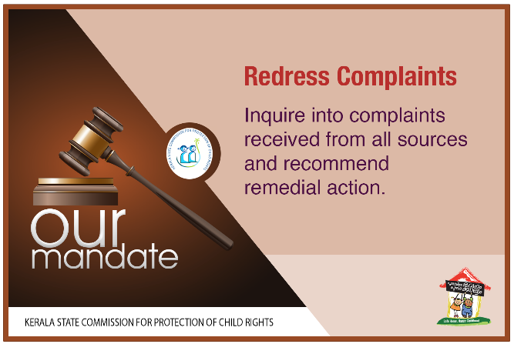
Towards Child Friendly Kerala

Slide 5

Towards Child Friendly Kerala

Slide 6
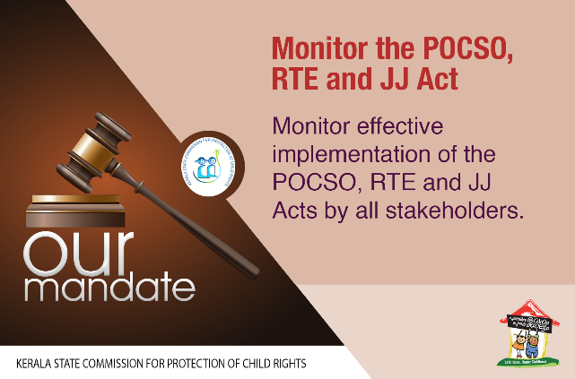
Towards Child Friendly Kerala

Slide 7

Towards Child Friendly Kerala

Slide 8


Slide 9

Towards Child Friendly Kerala

Slide 10
Composition of the KeSCPCR
The Commission consists of a Chairperson and six Members.
Chairperson Shri P Suresh
Smt Sreela Menon N Member
Shri M P Antoni Member
Shri C J Antony Member
Sr Biji Jose Member
Shri. K Nazeer Member
Fr. Philip Parakatt P V Member
Towards Child Friendly Kerala

Slide 11
Composition of the KeSCPCR
The Commission has following sections :
*Complaints *Administration
*Finance *Public Relations
In addition , the Commission have
* POCSO Cell *RTE Cell *J J Cell
Towards Child Friendly Kerala

Slide 12
Complaints Management
The Complaints Management cell -core unit of the commission
Cell processes the complaints of Child Rights violations received in written or suo moto/media reports
The Commission receives complaints and it has evolved a system of registration of complaints, issuing of letters seeking reports, following up with reminders
The complaints covers mainly on issues relating to denial of Right to Education, corporal punishment, violation of rights of children with disabilities, Child Sexual Abuse, Children put to vulnerable situations etc…
The Commission conducts follow up action on recommendations
Towards Child Friendly Kerala

Slide 13
Inquiry in to Complaints
Over the last 5 years of its existence, the Commission has handled and redressed a wide variety of complaints. The Orders in these cases are issued after obtaining reports from all concerned authorities. The number of cases received during the last 6 years up to 31.03.2019 are:-
Year | No. of Cases
2013-2014 | 127
2014-2015 | 863
2015-2016 | 1582
2016-2017 | 2512
2017-2018 | 2402 (up to 30.3.2018)
Towards Child Friendly Kerala

Slide 14
Complaints during 2017-18 (Till March 31, 2018)
Districts and Numner of Complaints |  |  |  |  |  | Total number of Complaints Redressed | Total number of Complaints to be Redressed
District | Total Numbers | RTE | POCSO | JJ | Denial of Child Rights
Thiruvananthapuram | 496 | 48 | 30 | 2 | 416 | 203 | 293
Kollam | 237 | 24 | 29 | 3 | 181 | 70 | 167
Pathanamthitta | 90 | 16 | 1 | 1 | 72 | 34 | 57
Alappuzha | 162 | 23 | 9 | 2 | 128 | 69 | 92
Kottayam | 122 | 14 | 13 | 0 | 95 | 56 | 66
Idukki | 91 | 7 | 6 | 0 | 78 | 53 | 38
Ernakulam | 189 | 27 | 21 | 3 | 138 | 79 | 110
Thrissur | 142 | 15 | 7 | 0 | 120 | 43 | 99
Palakkad | 133 | 16 | 10 | 0 | 107 | 54 | 79
Malappuram | 207 | 22 | 7 | 0 | 178 | 80 | 127
Kozhikkode | 244 | 23 | 19 | 0 | 202 | 112 | 132
Wayanad | 64 | 6 | 6 | 0 | 52 | 35 | 29
Kannur | 120 | 16 | 7 | 1 | 96 | 41 | 79
Kasaragod | 105 | 23 | 5 | 0 | 77 | 24 | 81
Total | 2402 | 280 | 170 | 12 | 1940 | 953 | 1449
Towards Child Friendly Kerala

Slide 15
Metholodologies for Interventions
For the KeSCPCR, it was appropriate to adopt several methodologies for interventions to gain access to information, compile them and recommend actions to be taken up by the State.
The following are the methods used by the commission:
Public hearing / sittings
Spot visit, vulnerable areas
Towards Child Friendly Kerala

Slide 16
Special Visits
The Commission undertakes visits to evaluate the progress of child rights issues in districts across Kerala and redress certain issues. During the visits, discussions are held with stakeholders
Some of important spot visit made by KeSCPCR :
Study on condition of migrant labourer’s children in Perumbavoor , Ernakulam
Tribal children in Edamalakkudy , Munnar
Children affected by Endosulfan in Kasargod
Spot visits to study
Problems of tribal children in Moozhiyar and Gavi as well as the children living in ‘R Block’ of Kuttanad, also visited Attappady and other tribal hamlets.
Towards Child Friendly Kerala

Slide 17
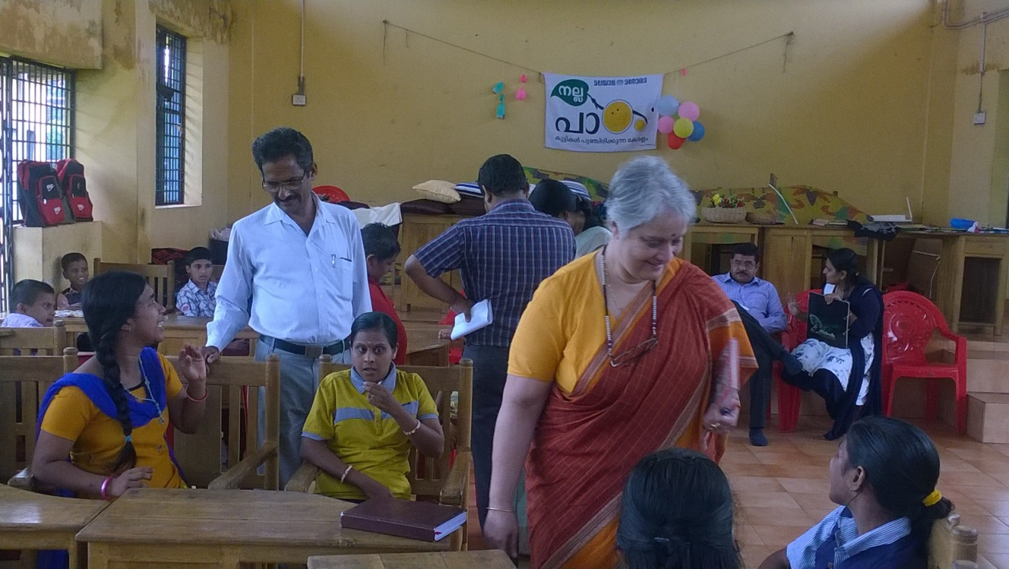
Smt.Shoba Koshy, Chairperson, KeSCPCR interacting with the Endosulphan affected children at a buds school during commissions visit in Kasaragod district
Towards Child Friendly Kerala

Slide 18
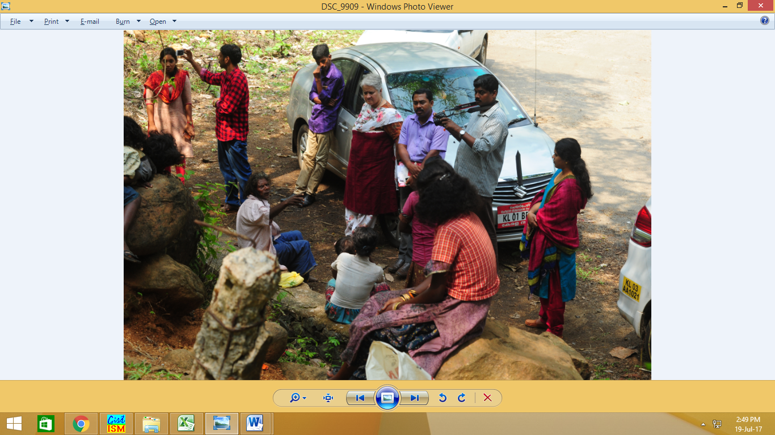
KeSCPCR team at the Tribal Hamlets in Pathanamthitta district
Towards Child Friendly Kerala

Slide 19
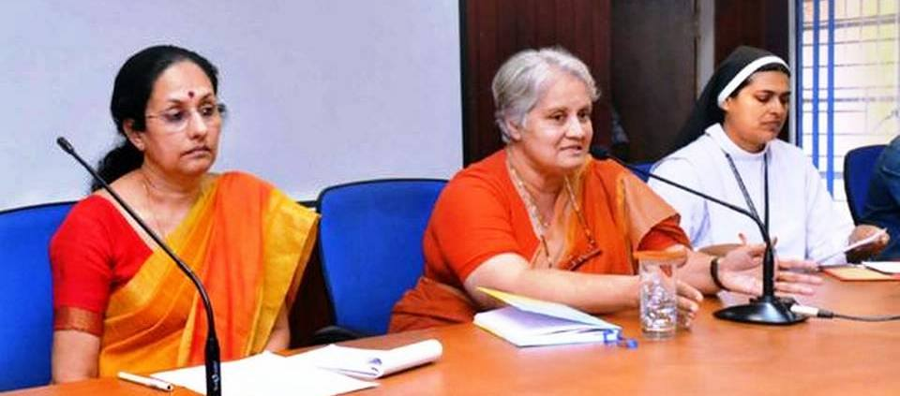
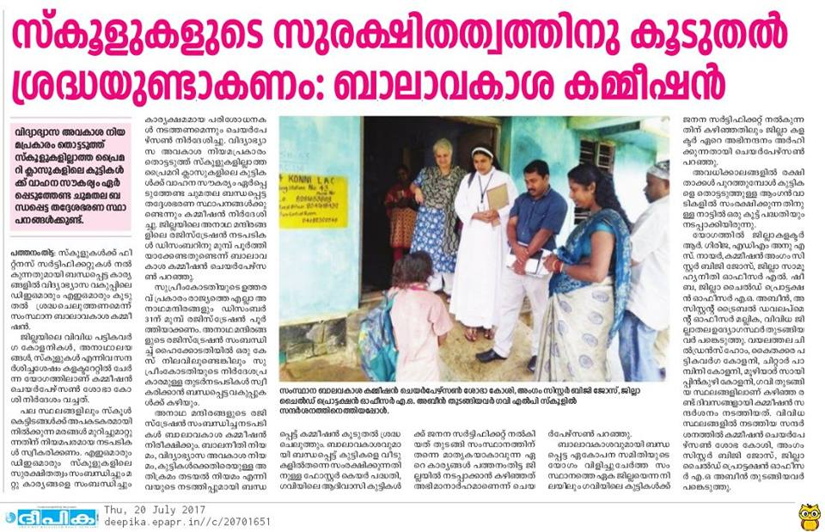
Smt.Shobha Koshy, Chairperson, Kerala State Commission for Protection of Child Rights addressing a meeting at the collectorate in Pathanamthitta. Sr.Biji Jose, Member, KeSCPCR, Smt.R. Girija, District Collector are also seen. (Pic courtesy: The Hindu)

Slide 20
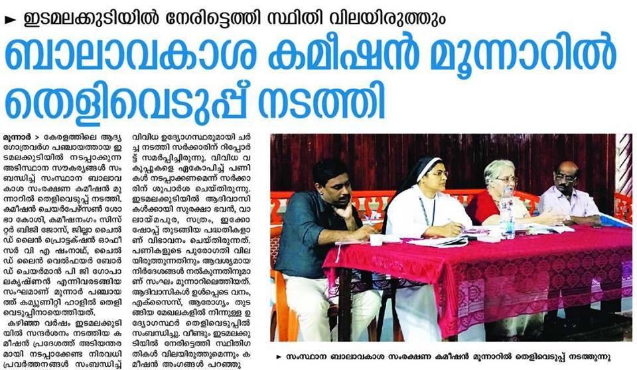
Spot Visit
KeSCPCR visited Edamalakudy, the tribal hamlets and made set of recommendations to improve the condition of tribal hamlets in Edamalakudy.
KeSCPCR sought an Action-taken report from the state government and the concerned tribal and district authorities on the set of recommendations to improve the condition of the tribal children and to empower the tribal community based on its visit to Edmalakudy.

Slide 21
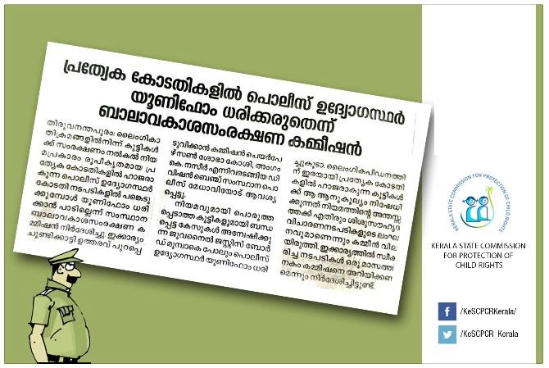
Important Recommendations
KeSCCPR issued an order to the Director-General of Police to ensure that police officers appearing in courts formed for hearing sexual abuse cases do not wear uniforms
Towards Child Friendly Kerala

Slide 22
Important Recommendations
MONITORING THE POCSO ACT
Over the last 5 years the Commission has developed a detailed monitoring system for all stakeholders involved in implementing the POCSO Act, 2012
The issues that have emerged from this monitoring have been shared with the respective authorities for further remedial action
MONITORING THE JJ ACT
One of the biggest challenges ahead in monitoring the implementation of the JJ Act would be to conduct the social audit of the Child Care Institutions (CCIs) registered under the JJ Act 2015
The Commission has been mandated to undertake this social audit
Towards Child Friendly Kerala

Slide 23
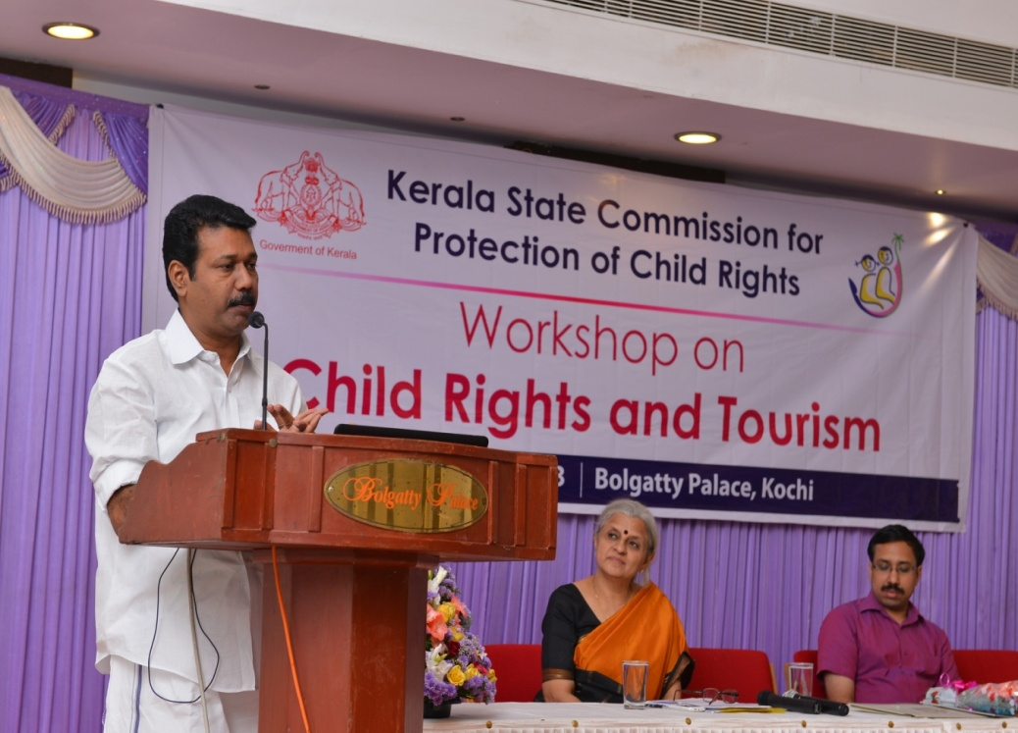
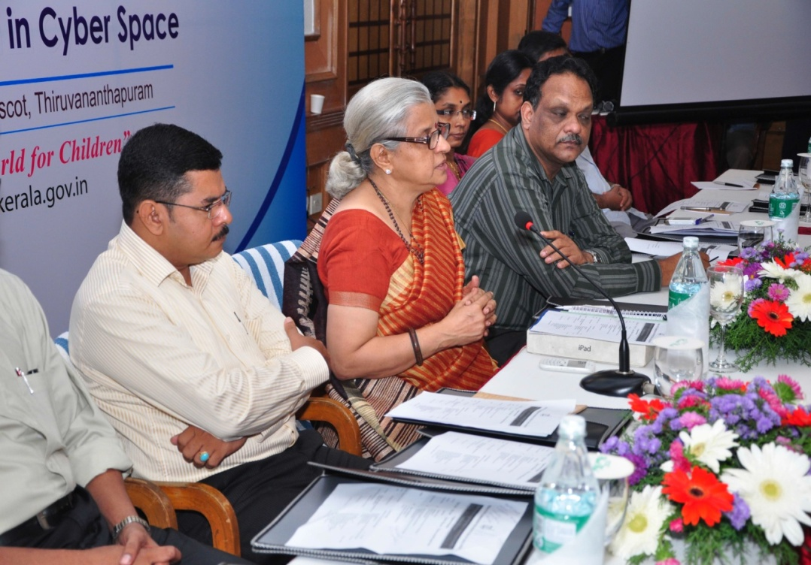
Sensitising Stakeholders: Consultations
Towards Child Friendly Kerala

Slide 24
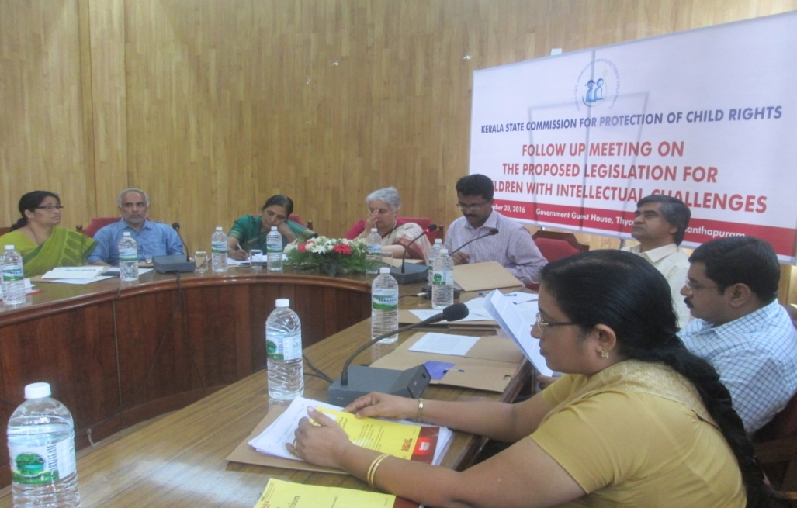
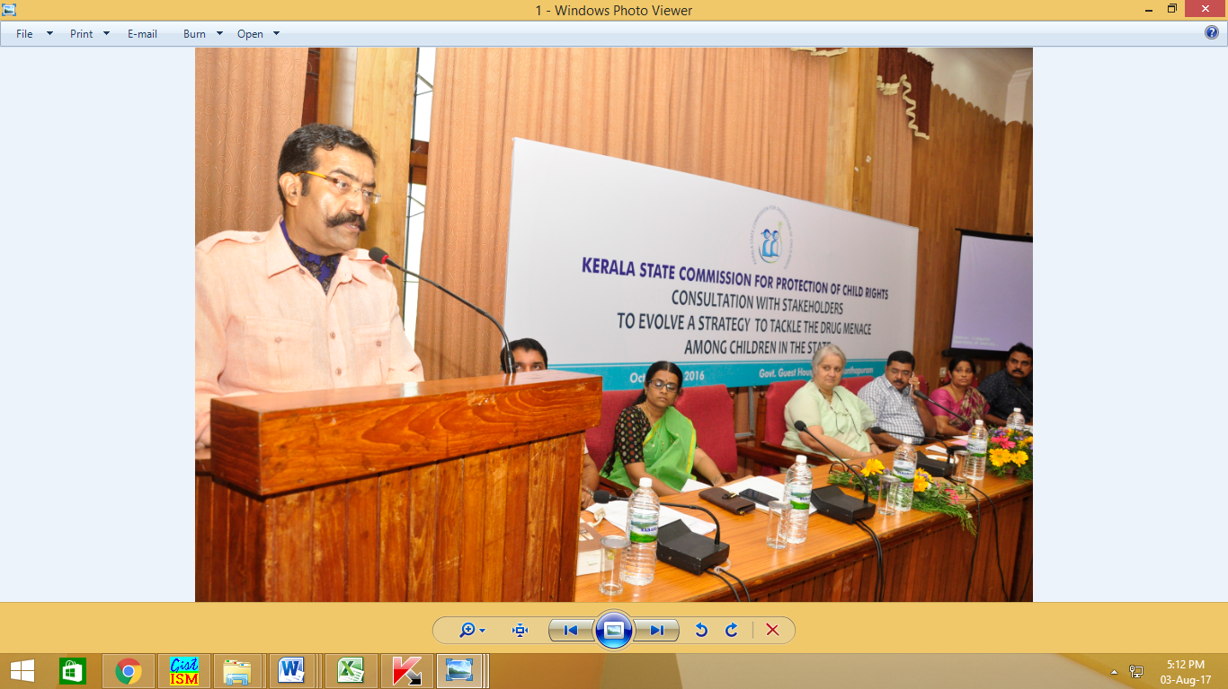
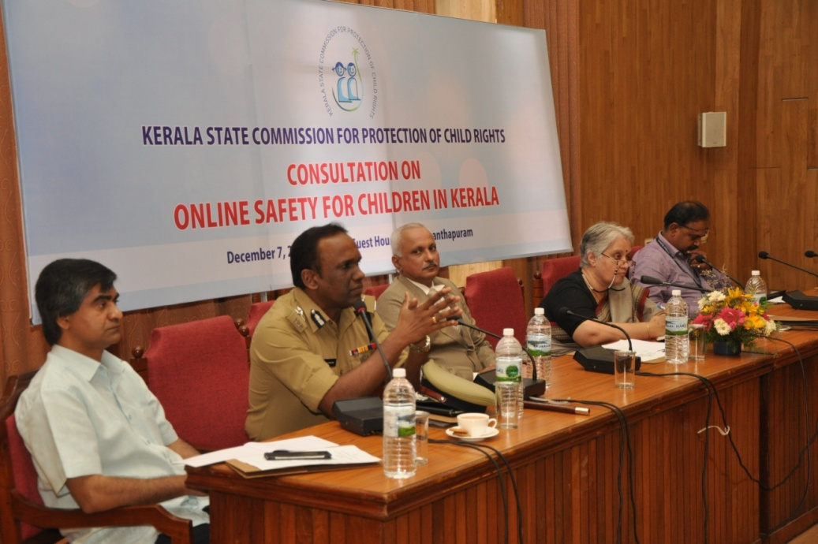
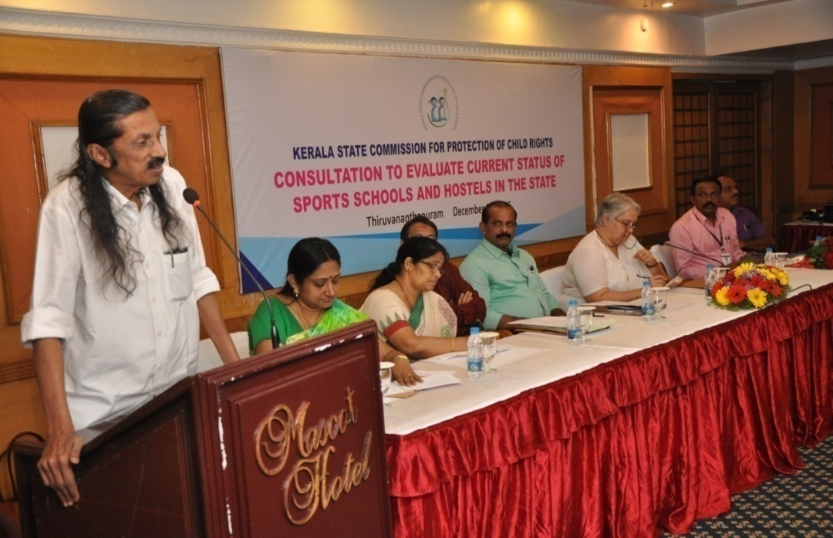
Sensitising Stakeholders: Consultations

Slide 25
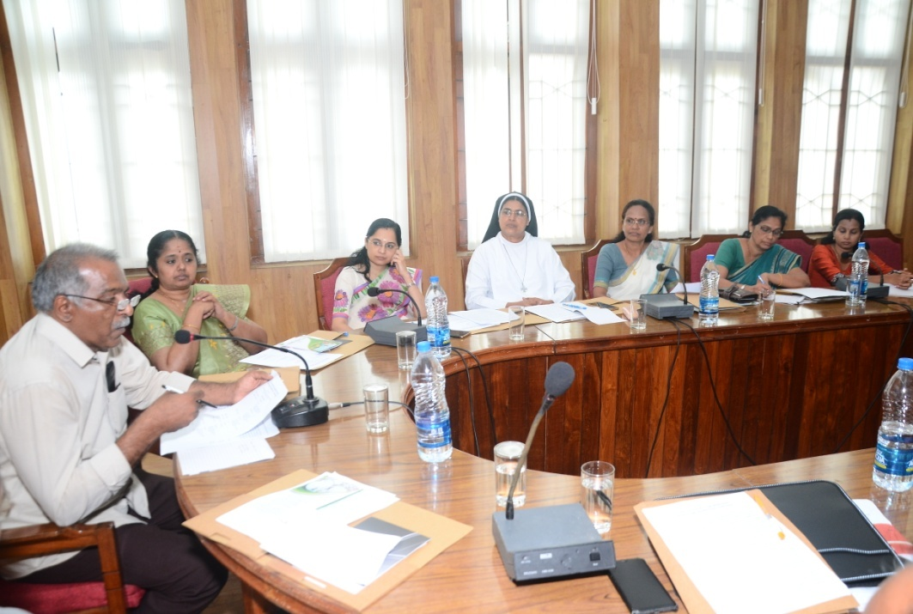
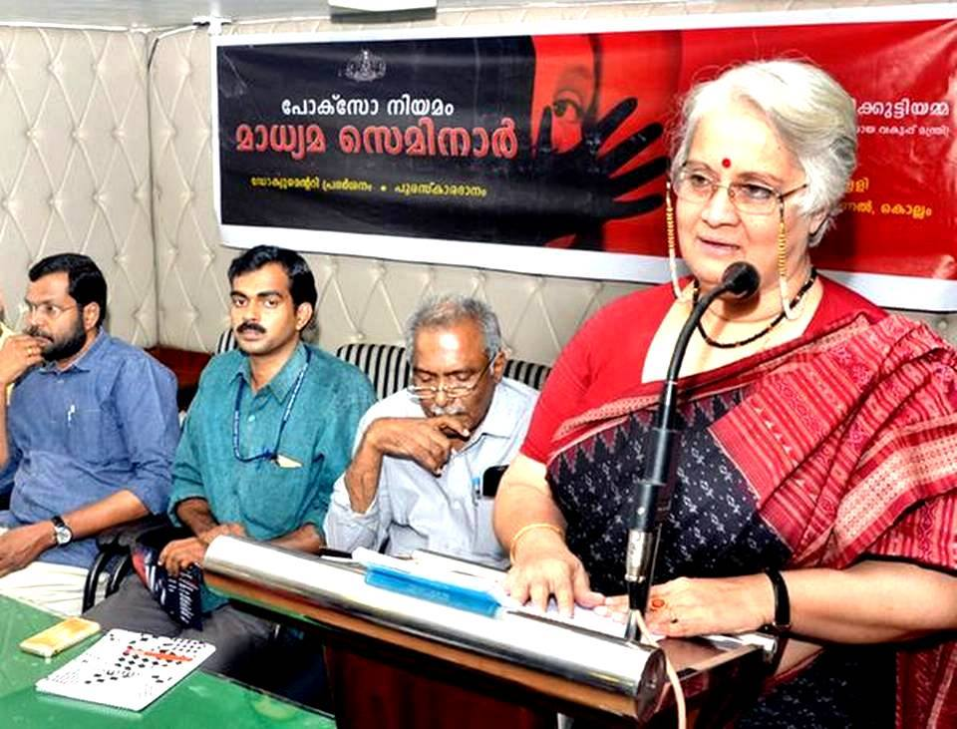
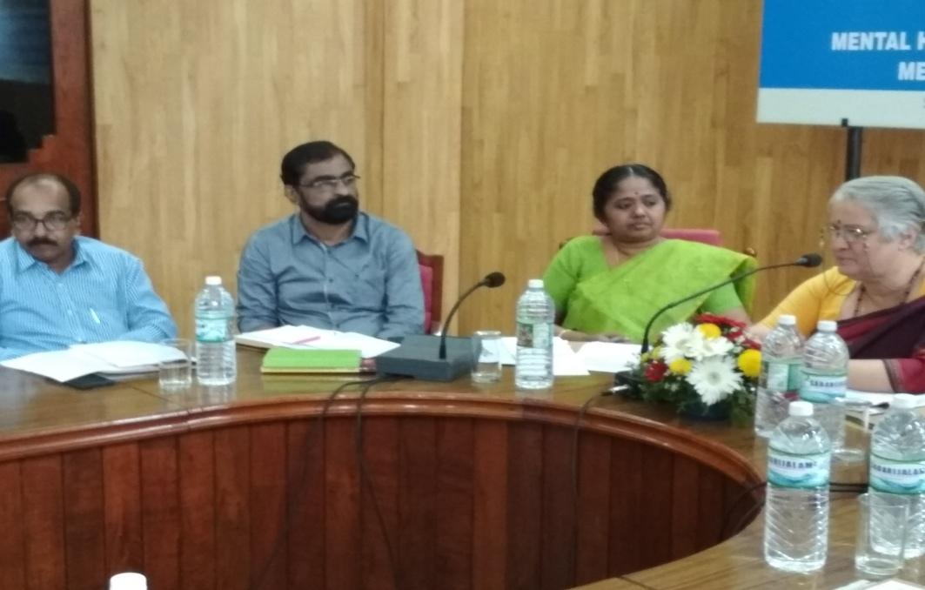
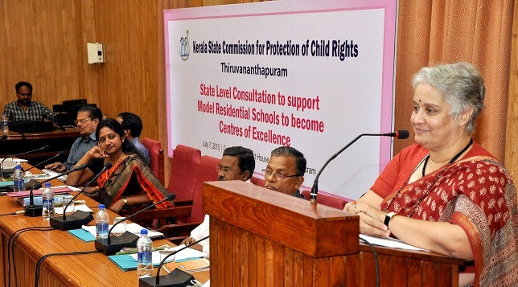
Sensitising Stakeholders: Consultations

Slide 26
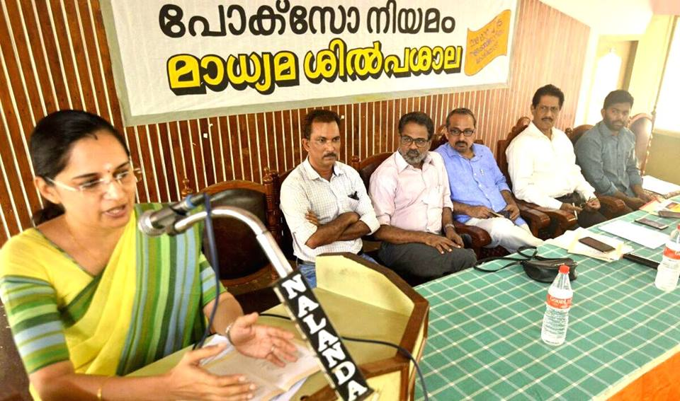
Seminar for Media on the POCSO Act jointly organised by the Information and Public Relations Department, Kozhikode Press Club, and Kerala State Commission for Protection of Child Rights.
Sensitising Media on POCSO
Towards Child Friendly Kerala

Slide 27
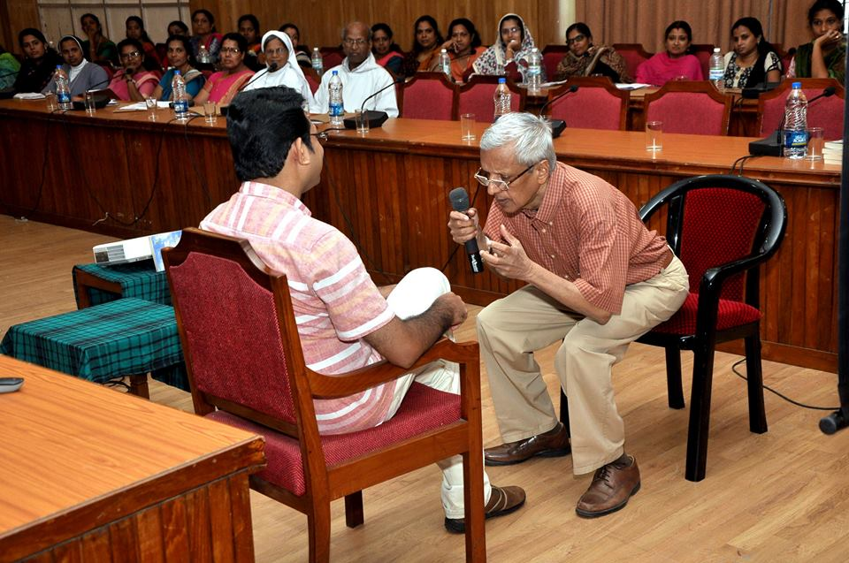
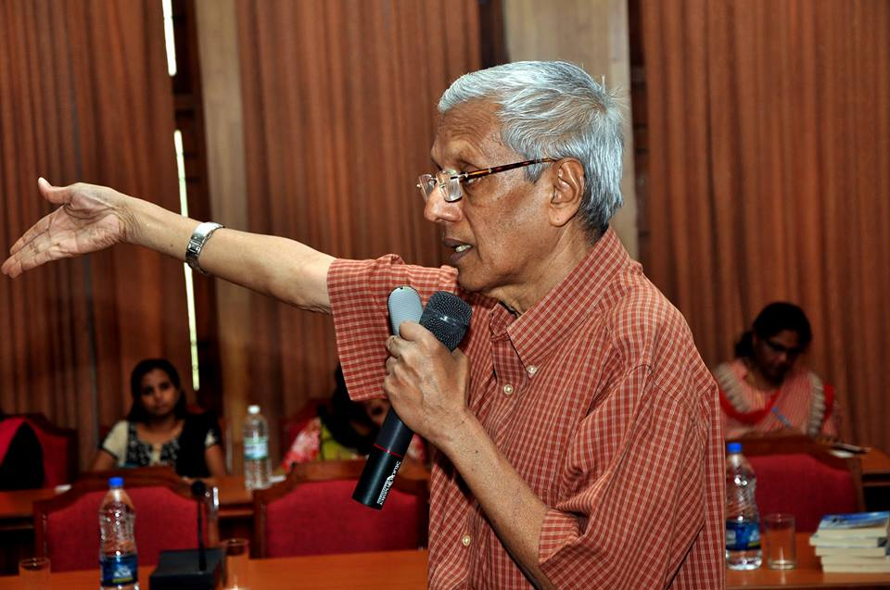
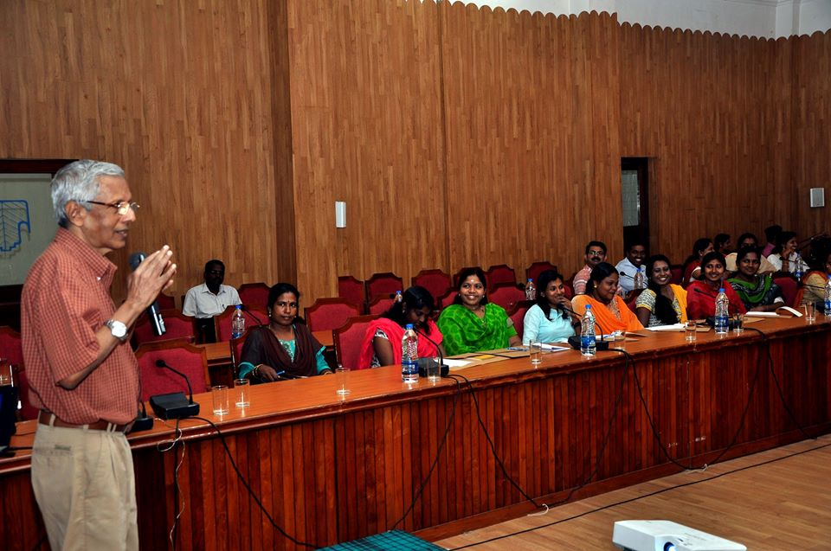
Sensitising Stakeholders:
Counsellor’s Meet
Organised by KeSCPCR , many school counsellor’s took a day off from their mundane work to participate and learn about the Child Rights and related aspects
In a bid to sensitise Counsellor’s on Child Rights and Child Protection, KeSCPCR organized Counsellor’s Meet in Kollam, Alappuzha, Kasaragod for the Counsellor’s to understand that ensuring a child’s rights are not violated and tips for them while counselling children.
The workshop was facilitated by Dr. A. Abraham MD, Director - Training, MindMasters, is a Certified Practitioner in Neuro - Linguistic Programming, (UK)
Towards Child Friendly Kerala

Slide 28
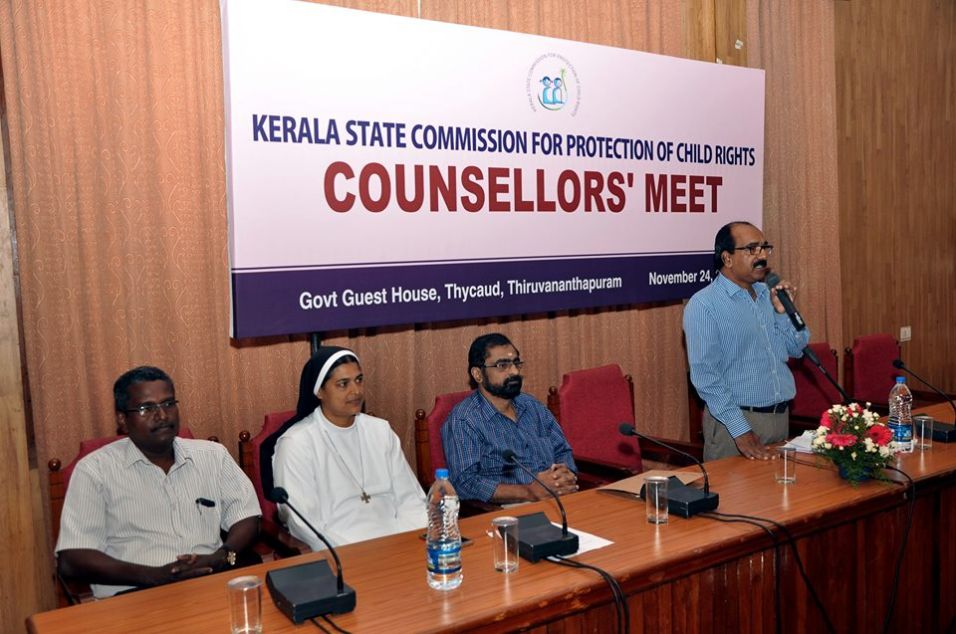
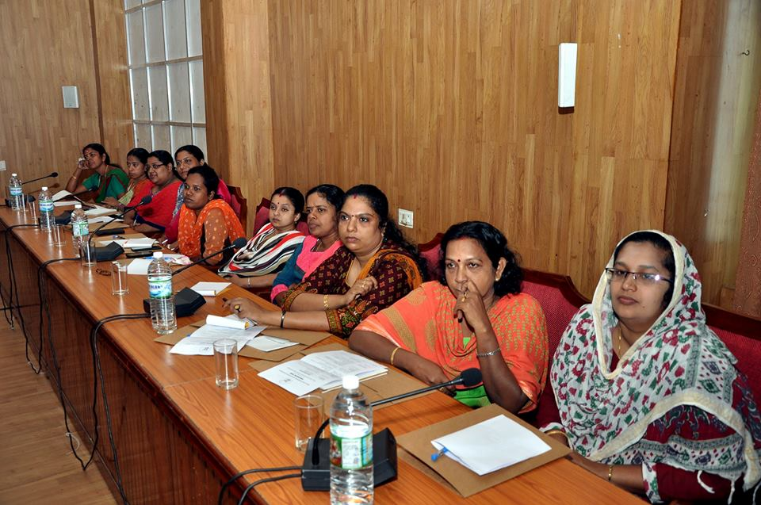
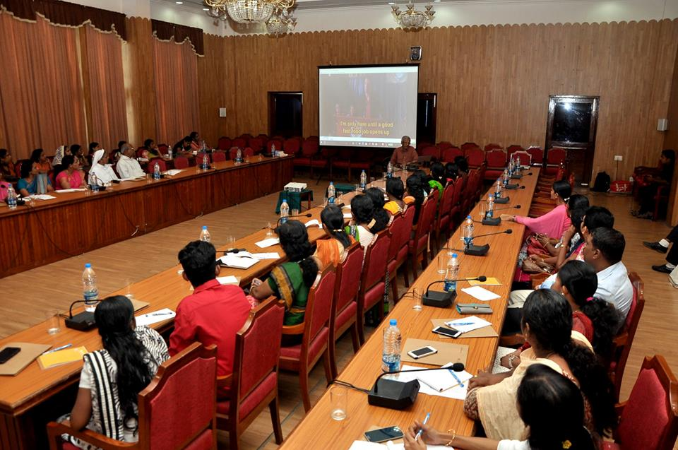

Slide 29
Samvadam
Child participation- KeSCPCR believe that when children are heard and involved, systematic changes would impact their lives positively has grown even stronger
A successful example- held across Kerala for children, Samvadam provides a platform for children to share their issues faced by them.
Allows children to be heard and seek support of government systems. Organised in each districts by KeSCPCR, Govt officials, Police, NGO members, other concerned are invited to the Samvadam to participate.
During the workshops, children are sensitized on child rights and child protection. This is followed by a discussion with District Administration facilitated by KeSCPCR in which Children share their problems and issues faced by them.
Towards Child Friendly Kerala

Slide 30
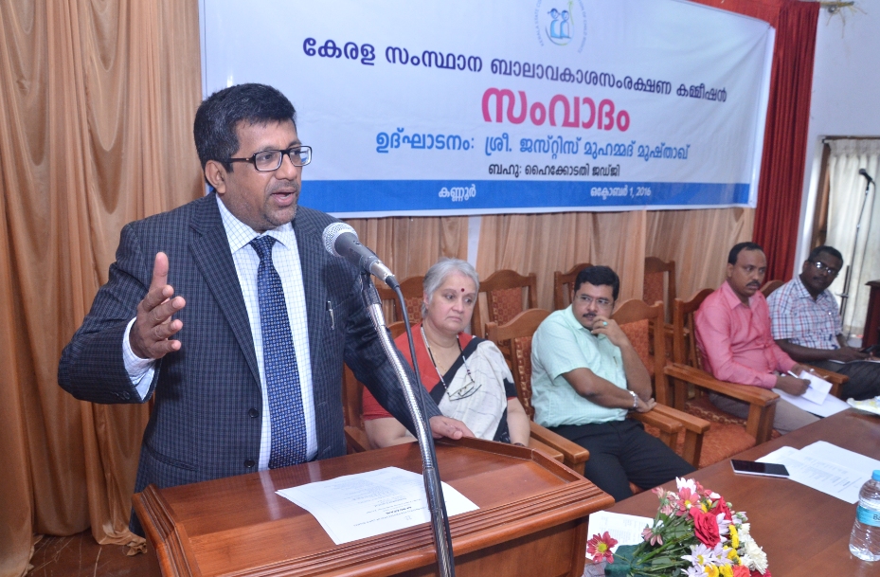
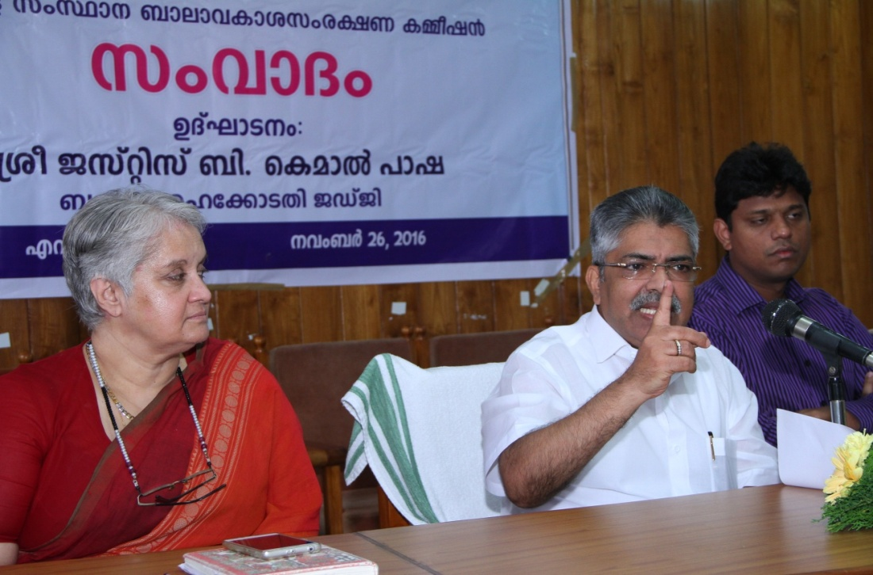
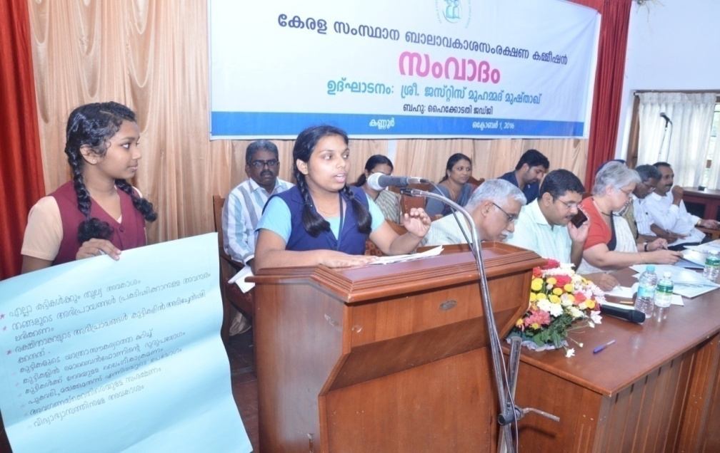
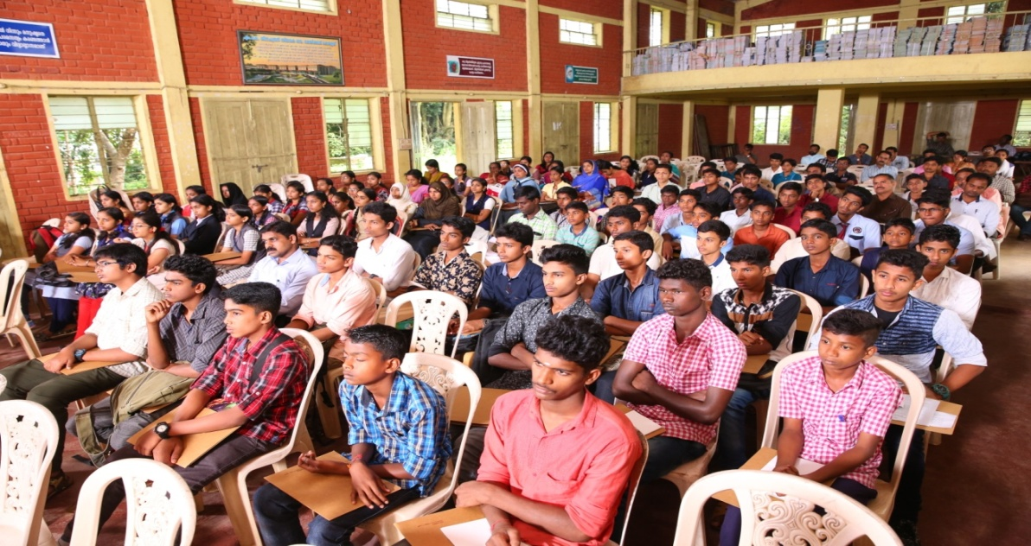
Samvadam – an interactive participatory session is also being held in every district across Kerala through which awareness on child rights have been imparted to the selected school children
Towards Child Friendly Kerala

Slide 31
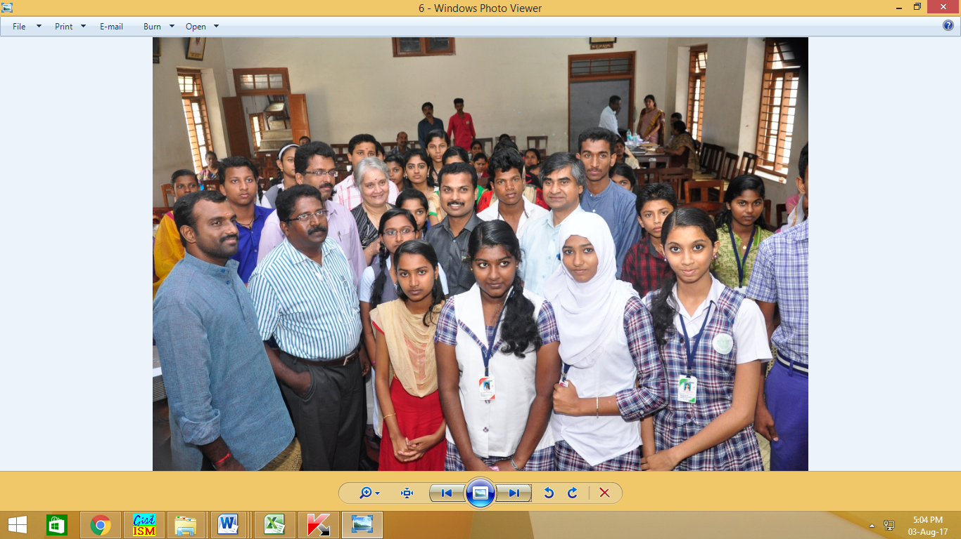
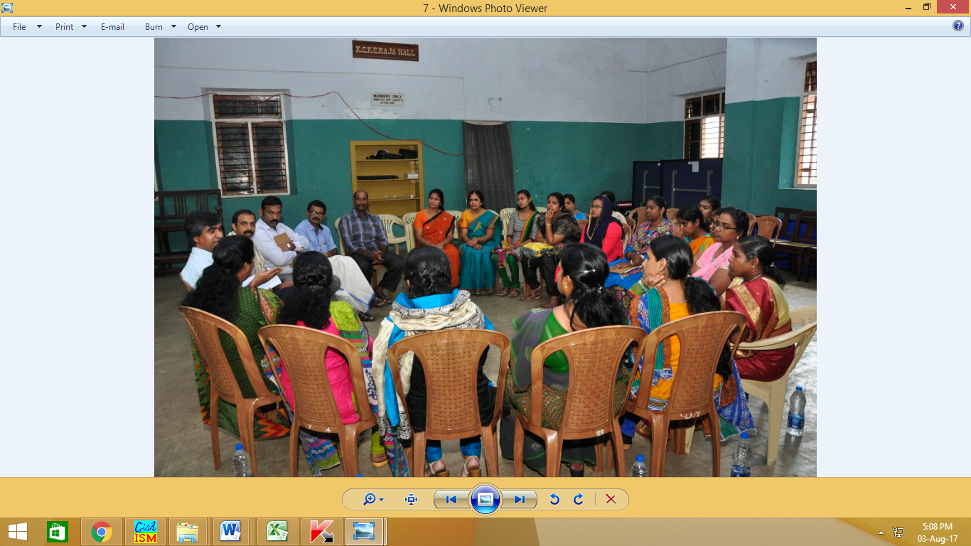
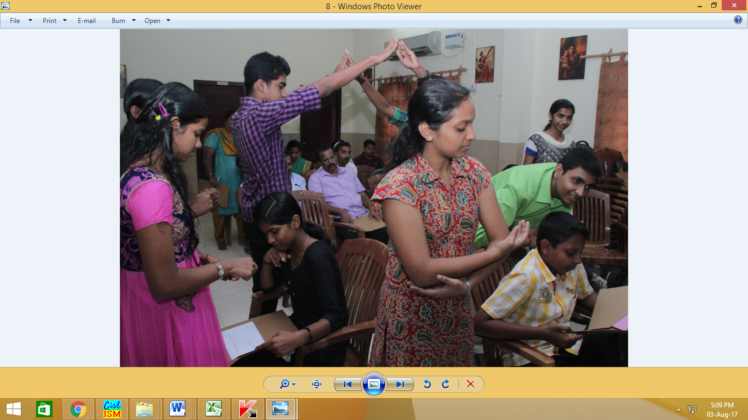
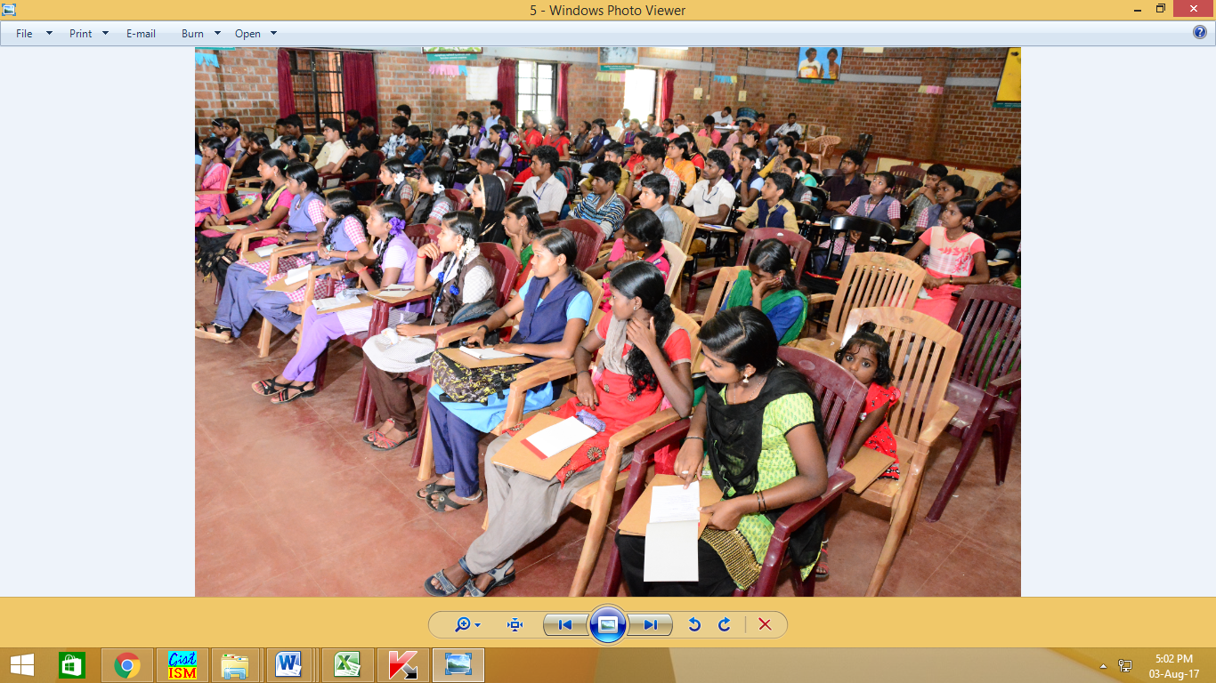
Towards Child Friendly Kerala

Slide 32
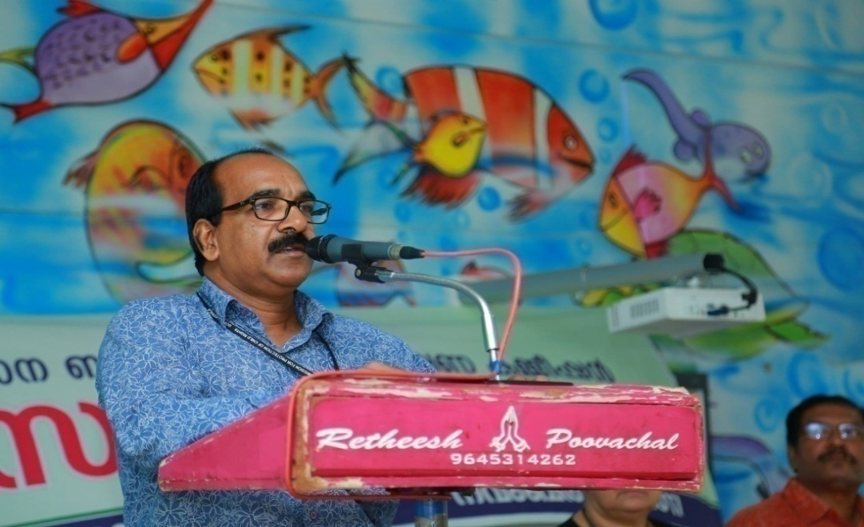

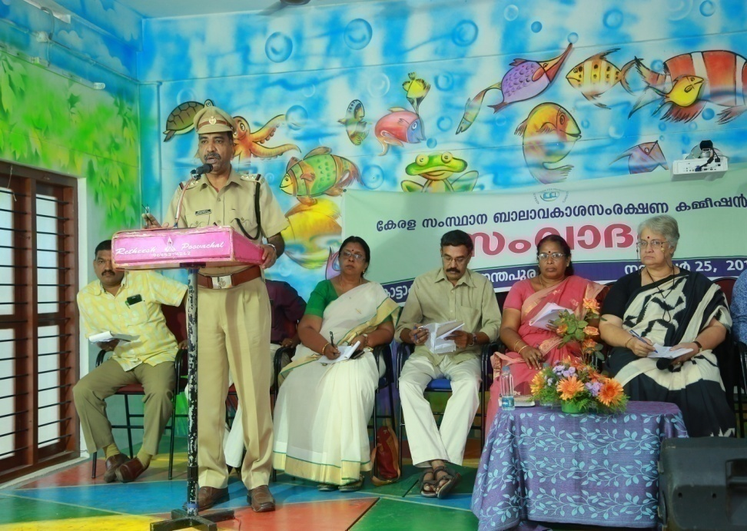
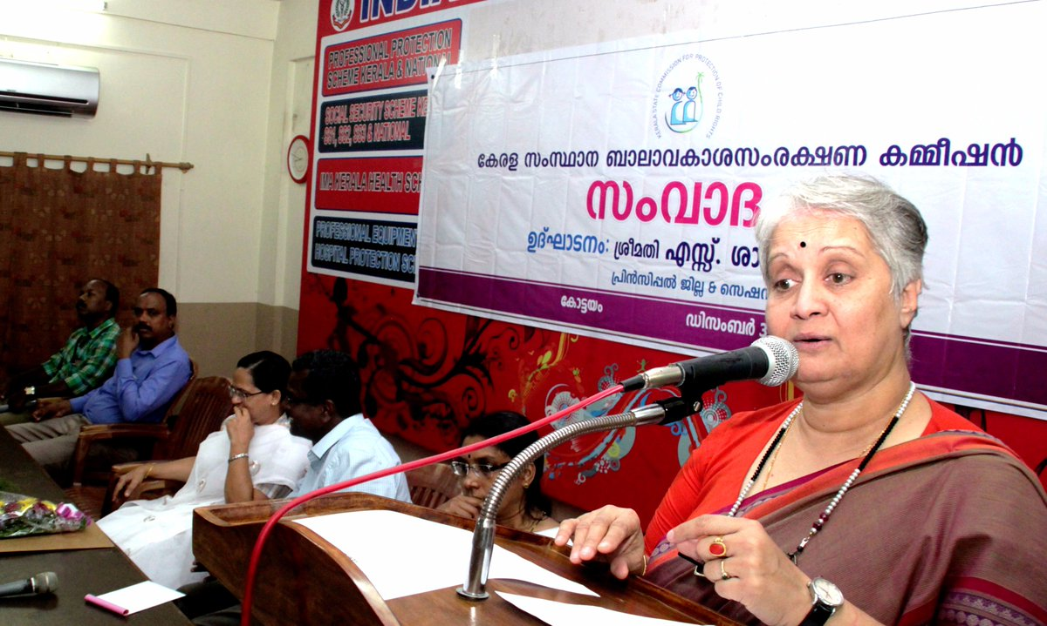
Towards Child Friendly Kerala

Slide 33
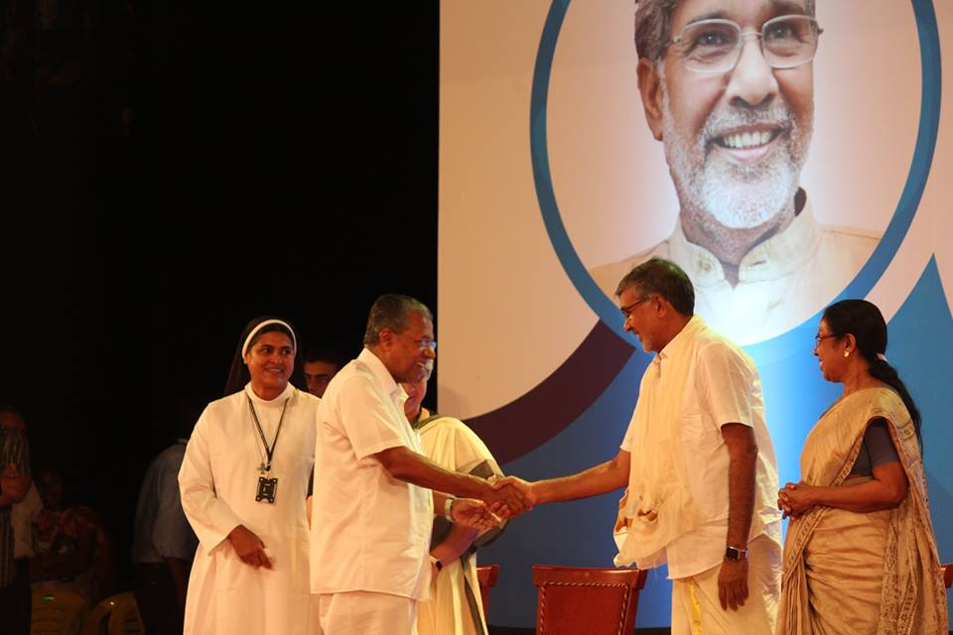
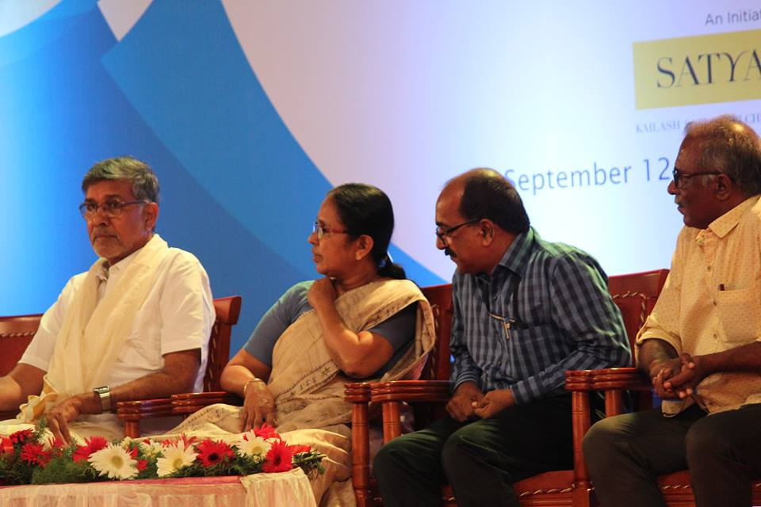
An afterNOON with Kailash Satyarthi
Addressing an interaction organised by the KeSCPCR in connection Bharat Yatra, Shri. Satyarthi said silence on the matter emboldened those committing the crimes. "Every hour two children get abused and eight children go missing in the country. No one can refuse the right of a child to childhood. A child knows no boundaries and irrespective of all geographical boundaries, the children should be protected ensuring their joy, freedom and dignity of life."
Towards Child Friendly Kerala

Slide 34
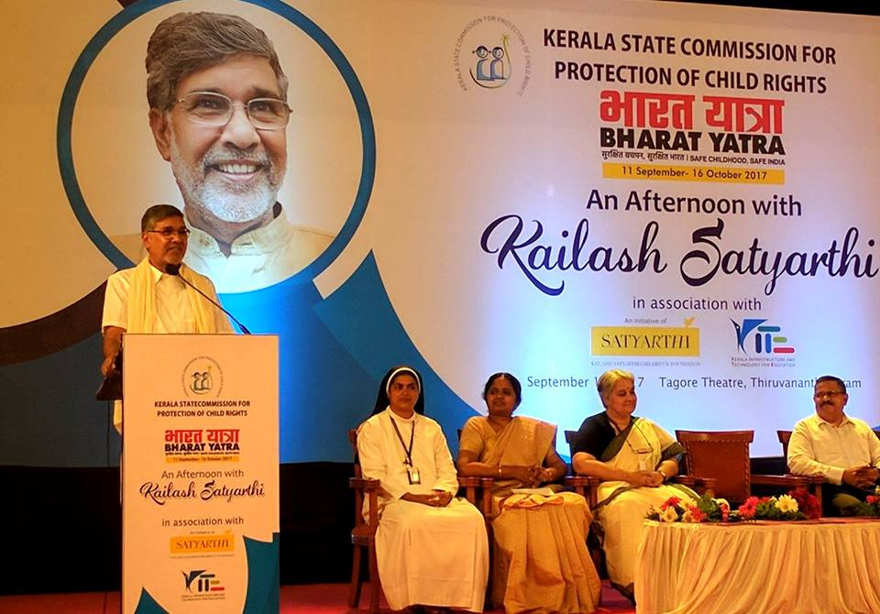
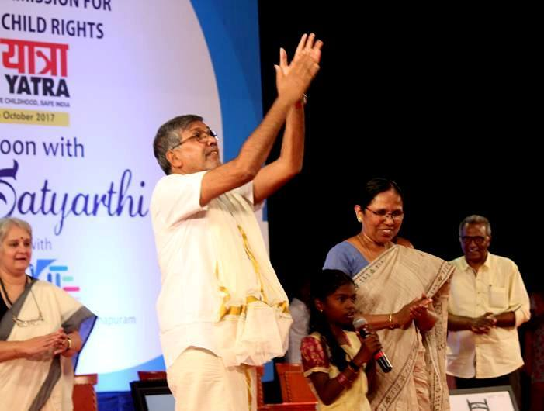
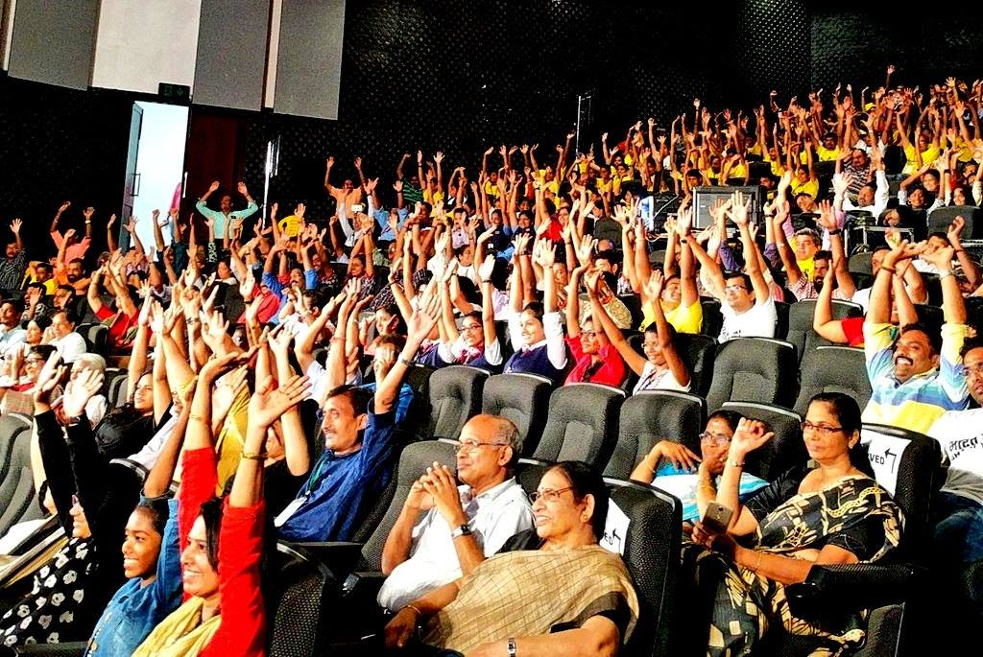
An afternoon with
Towards Child Friendly Kerala

Slide 35
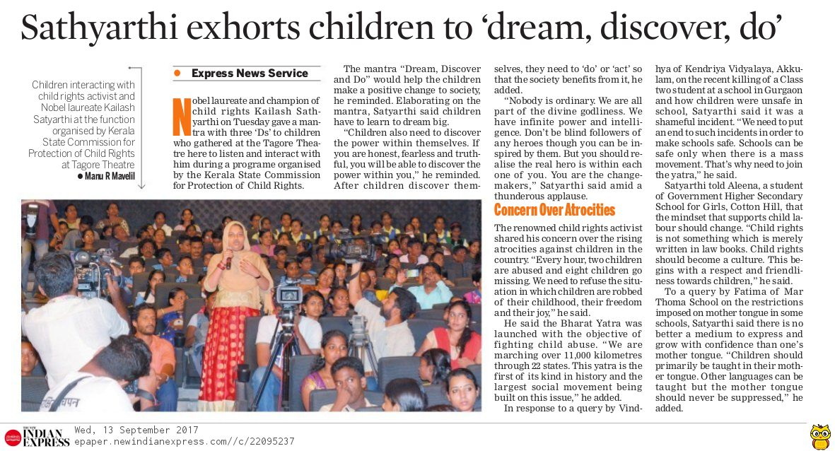
Towards Child Friendly Kerala

Slide 36

CHILD RIGHTS WEEK CELEBRATIONS
Every year Commission celebrates the Child Rights Week (November 14 -20) in collaboration with the District Child Protection Officers in every district who, along with NGOs and student volunteers, propose to create greater awareness Various activities and public engagements have been planned across the state in this regard. These include the following activities directly taken up by the Commission.
Towards Child Friendly Kerala

Slide 37
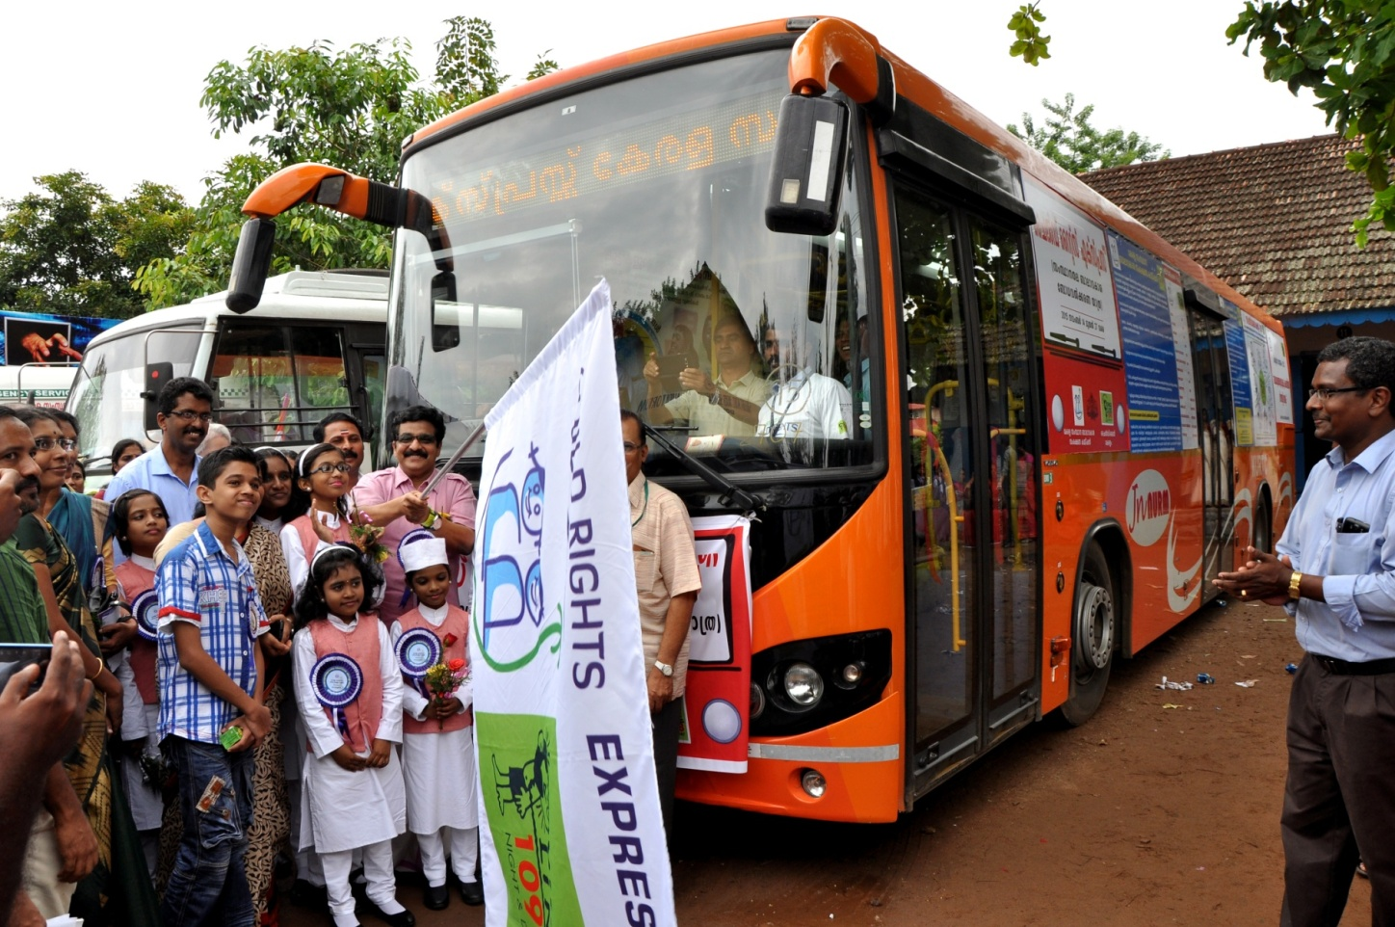
CHILD RIGHTS WEEK CELEBRATIONS
Towards Child Friendly Kerala

Slide 38
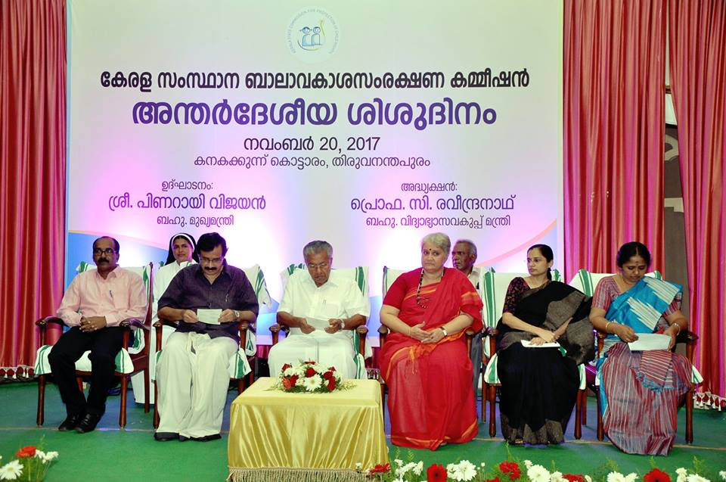
CHILD RIGHTS WEEK CELEBRATIONS

Slide 39
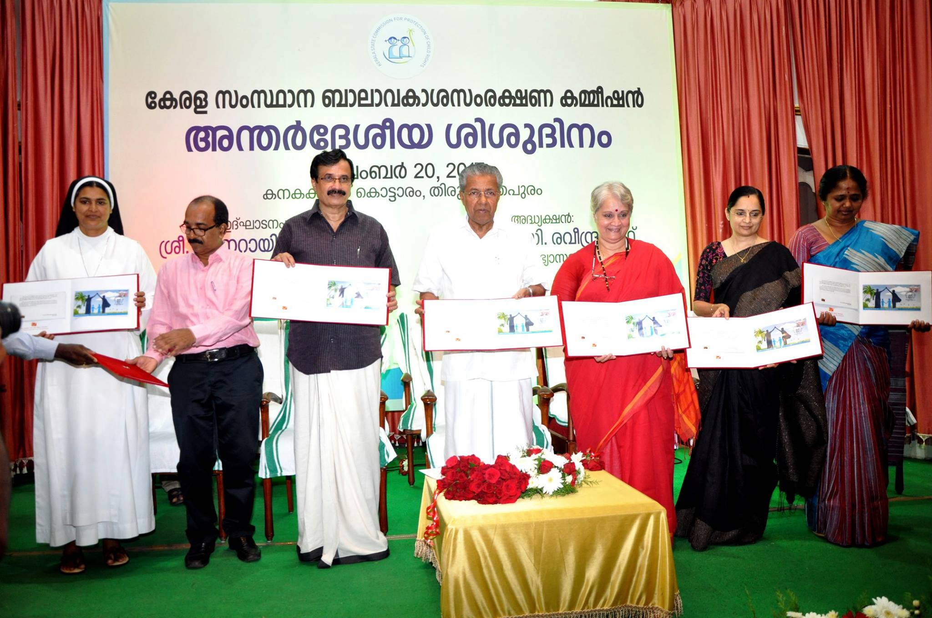
Special (postal) cover on Child Rights
Shri. Pinarayi Vijayan, Chief Minister releasing a special postal cover to commemorate the silver jubilee of India ratifying the U.N. Convention on the Rights of the Child . Also seens are Prof. C. Raveendranath, Minsister , Education, Team KeSCPCR
Towards Child Friendly Kerala
Commemorating 25th year of UNCRC

Slide 40
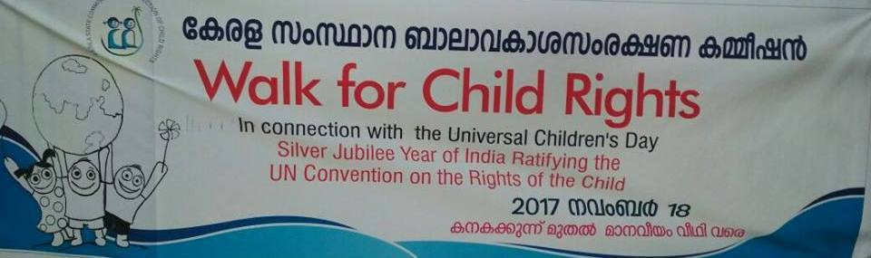
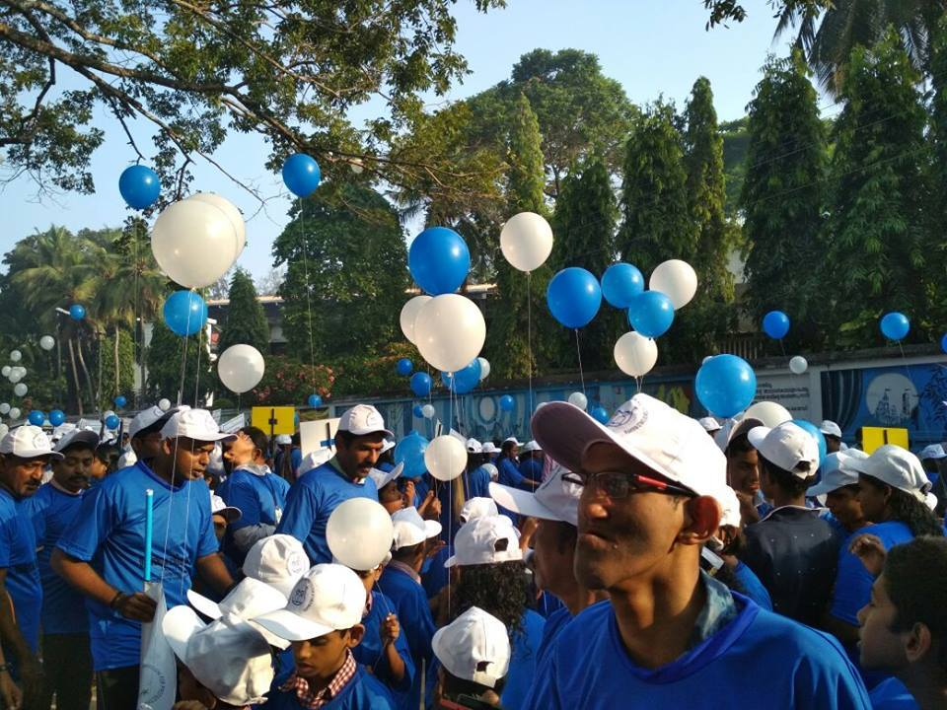
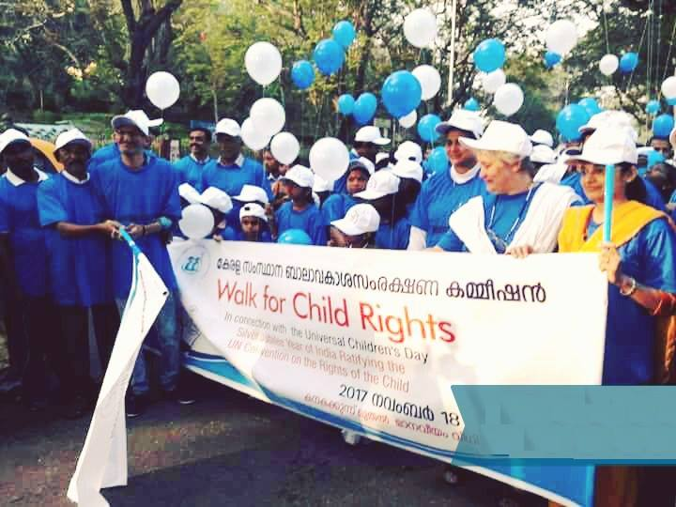
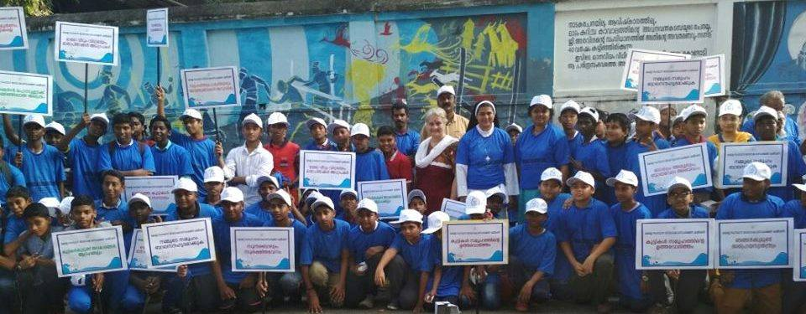
Walk for Child Rights

Slide 41

Child Friendly Local Governance (CFLG) Initiative
KeSCPCR facilitated the Kerala Institute of Local Administration (KILA) and UNICEF in the Child Friendly Local Governance (CFLG) initiative in selected districts.
KeSCPCR releases operations manual for child-friendly governance in Kerala

Slide 42
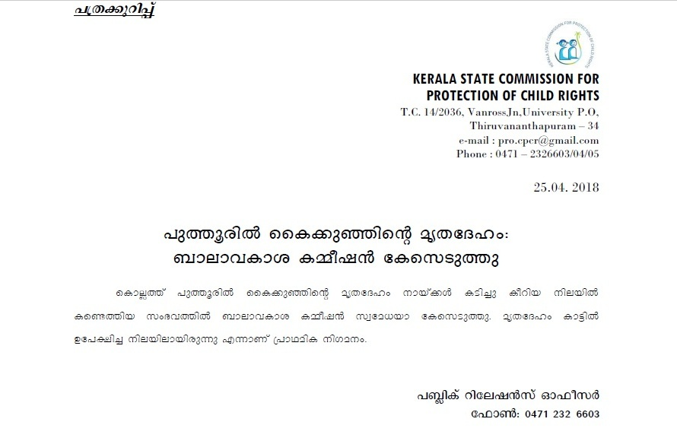


Communication and Media tools
Press releases are issued based on the decisions and orders of the Commission and any important updates from the commission

Slide 43

Research & Publications
Hand Book on Child Rights & POCSO Act 2012
Report on Endosulphan Victims in Kasaragod
Report on the conduct of the School Kalolsavam
Report on the commission visits to the tribal areas of Attappadi,Palakkad
Report on the Commission Visit to the tribal areas of Edamalakkudi
Report on the functioning of Govt Regional Fisheries Technical and Vocational Higher Secondary Schools and Hostels
Report on strengthening counselling schools and child care homes
Report on the problems of children in Kerala who are infected and affected by HIV/AIDS
Report on the status of Pre Primary Education in Kerala
Report on the consultation of the Victim Compensation Scheme
Report on the impact of exemption given to schools from the general calendar
Report on visit to the tribal areas of Pottamavu,Trivandrum
Report on visit of the commission to study the living conditions of children in tea garden of Peerumedu
Report on conflict between the POCSO Act and traditional tribal customs and practices.
Report on status of facilities available for Breast Feeding in the IT sector.
Report on challenges faced by tribal children in the CCIs at Agali, Attappady.
The Commission brings out comprehensive reports based on the Consultations arranged on various topics related child rights.
Towards Child Friendly Kerala

Slide 44

News Bulletin: Balyam
KeSCPCRs ‘Balyam’ is an in-house news bulletin that covers the significant activities KeSCPCR undertakes on a regular basis in Malayalam.
Balyam, the bimonthly publication acts as a crucial tool to share information about KeSCPCR and best practices.
Balyam- a quarterly newsletter is being brought out incorporating the orders of the Commission, action taken report submitted by various stake holders and the programmes and consultations conducted by the Commission.
Towards Child Friendly Kerala

Slide 45



Slide 46




Media Interactions:
KeSCPCR In the news
Towards Child Friendly Kerala

Slide 47


Media Interactions:
KeSCPCR In the news
Towards Child Friendly Kerala

Slide 48


Media Interactions:
KeSCPCR In the news
Towards Child Friendly Kerala

Slide 49


Media Interactions:
KeSCPCR In the news

Slide 50


Towards Child Friendly Kerala

Slide 51

Tools of Change: ‘No Go Tell’ Short Film
Film produced for the KeSCPCR featuring actor Nivin Pauly to create awareness among kids about the possibility of experiencing bad touch and what has to be done.
Directed by Jude Anthany Joseph and produced by Bodhini Metropolis Charitable Trust with support from Muthoot Pappachan Foundation.
Towards Child Friendly Kerala

Slide 52

Tools of Change: ‘No Go Tell’ Short Film
Taking it to his Facebook page, Actor Nivin Pauly wrote a heartwarming message on child abuse and expressed his happiness to be part of the project. The short film, which was released on Youtube had gone viral and has garnered more than 2 lakh views on YouTube.
Towards Child Friendly Kerala

Slide 53

Tools of Change: KeSCPCR on Facebook
www.facebook.com/KeSCPCRKerala
Towards Child Friendly Kerala

Slide 54

Tools of Change: KeSCPCR on Twitter
www.twitter.com/KeSCPCR_Kerala
Towards Child Friendly Kerala

Slide 55



Social Media campaigns
Child Rights week campaign on Facebook and Twitter
Towards Child Friendly Kerala

Slide 56




Social Media campaigns
Towards Child Friendly Kerala

Slide 57

Responsive and well rated FB page
Towards Child Friendly Kerala

Slide 58


Google listing ratings/ reviews
Towards Child Friendly Kerala

Slide 59
Action Plan:2018-2019 (Summary)
Focus for 2018-19
Grassroot level convergence of stakeholders for the promotion of Child Rights through Local Self Government (LSGS)
Promotion of Child Rights through Schools on Safe Touch/Child Safety aspects, Drug Abuse
Towards Child Friendly Kerala

Slide 60
Action Plan:2018-2019 (Summary)
Contd..
General:
Biannual Review Meeting of monitoring of RTE Act
Biannual Review Meeting of monitoring of POCSO Act
Biannual Review Meeting of monitoring of JJ Act
Biannual Review Meetings of CWC & JJB Members
Biannual Review Meetings of DCPU’s
Biannual Review Meetings of CHILDLINE partners
Samvadam with Child representatives of CPC’s under LSG’s
Observation of Child Rights Week (14 districts)
Universal Children’s Day Observation (State Level Meet of CPC Chairperson, Conveners and Child representatives of CPCs under LSGs)
Towards Child Friendly Kerala

Slide 61
Action Plan: 2018-2019 (Summary) Contd..
Training Programmes:
40 Numbers of Training-Cum-Awareness programmes at all districts inviting
CPC Chairman, Vice Chairman and Convenors of CPC’s at LSG’s
Training-Cum-Orientation Programme to CC1 Superintendents – 3 Regional level Programmes
Training for Public Prosecutors - POCSO
Towards Child Friendly Kerala

Slide 62
Action Plan: 2018-2019 (Summary) Contd..
Consultations:
‘Good Touch; Bad Touch’ curriculum development for LP and UP school children.
Consultation on the status of Pre-metric hostels and measures to improve their condition.
Consultation on the station of sports schools and sports hostels in relation to children’s safety and well being
Consultation on drug menace among school children
Consultation with stakeholders on out of school/drop out children
Towards Child Friendly Kerala

Slide 63
Action Plan: 2018-2019 (Summary) Contd..
Research studies:
Social Auditing at CCI’s registered under JJ Act
Evaluation on the measures to tackle the drug menace among school children
Study on the situation of children of convicted prisoners
Study on the challenges faced by children under Nirbhaya Homes.
Study on Child Marriage in the state of Kerala.
Status of awareness/knowledge among school teachers on positive disciplining
Awareness Programmes:
Guidance Book on Social Auditing at CCI’s
Developing FAQ-JJ Act 2015
Programme in connection with the 2nd Anniversary
Promotion of Foster care with special focus on kinship foster care with or without sponsorship(Data compilation Poster, Film & Awareness Programme at all the 14 districts
Towards Child Friendly Kerala

Slide 64


Towards Child Friendly Kerala
KERALA STATE COMMISSION FOR PROTECTION OF CHILD RIGHTS

Slide 65

Towards Child Friendly Kerala
KERALA STATE COMMISSION FOR PROTECTION OF CHILD RIGHTS

Slide 66

KERALA STATE COMMISSION FOR PROTECTION OF CHILD RIGHTS

Slide 67

Towards Child Friendly Kerala

